Slide 1
Supercomputing Basics
John Mulligan, CRC, HRC
jcm10@rice.edu
Useful code for today at: https://github.com/JohnMulligan/ariel-demo

Slide 2
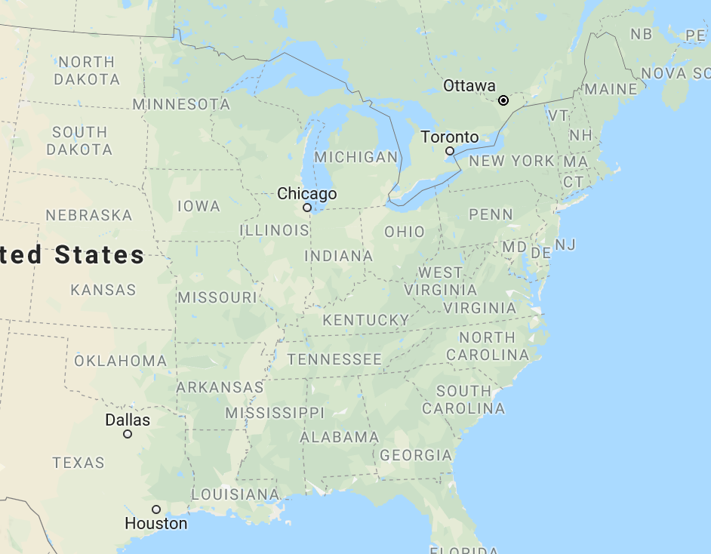


What is supercomputing? More cores not faster cores
Rice’s DAVinCI: 2400 processors in 192 nodes that can communicate with one another
Rice’s NOTS: 2784 processors in 158 nodes – no cross-node communication

Slide 3
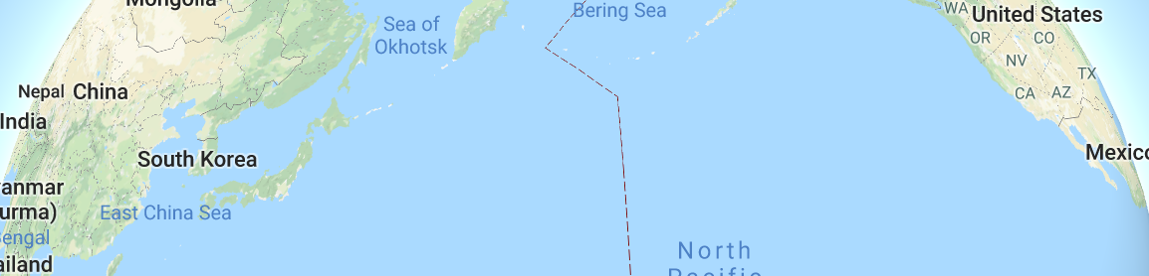

What is supercomputing? More cores not faster cores
Rice’s DAVinCI: 2400 processors in 192 nodes that can communicate with one another
Rice’s NOTS: 2784 processors in 158 nodes – no cross-node communication

Slide 4
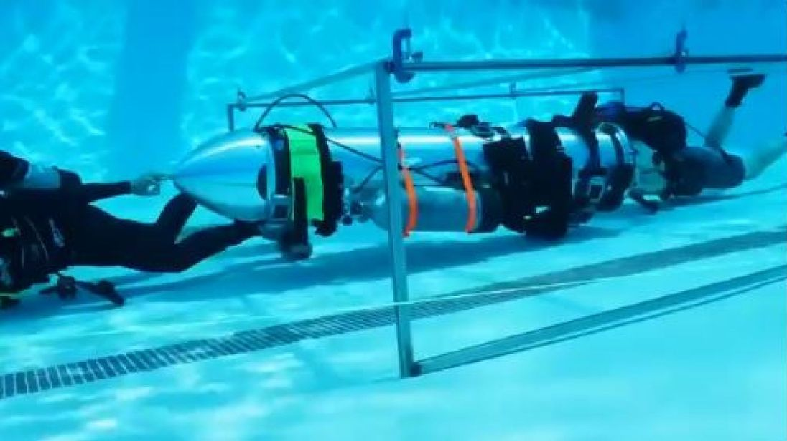
What is supercomputing? More cores not faster cores
Rice’s DAVinCI: 2400 processors in 192 nodes that can communicate with one another
Rice’s NOTS: 2784 processors in 158 nodes – no cross-node communication

Slide 5
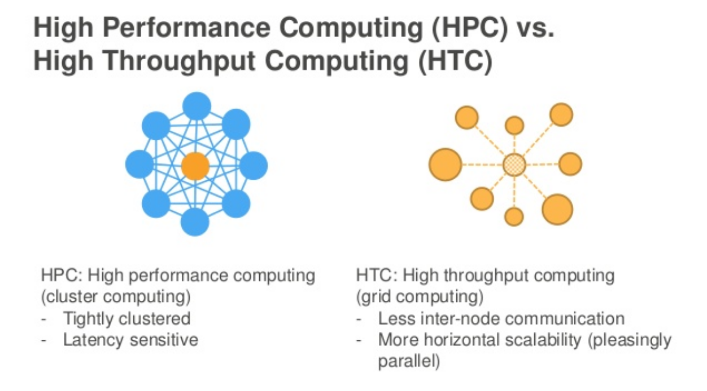
What is supercomputing? HTC vs. HPC (serial vs. parallel)
University of Madison Wisconsin’s CHTC: 30,000 cores – no cross-processor communication
Image via AWS re:Invent 2016: Building HPC Clusters as Code in the (Almost) Infinite Cloud (CMP318)

Slide 6
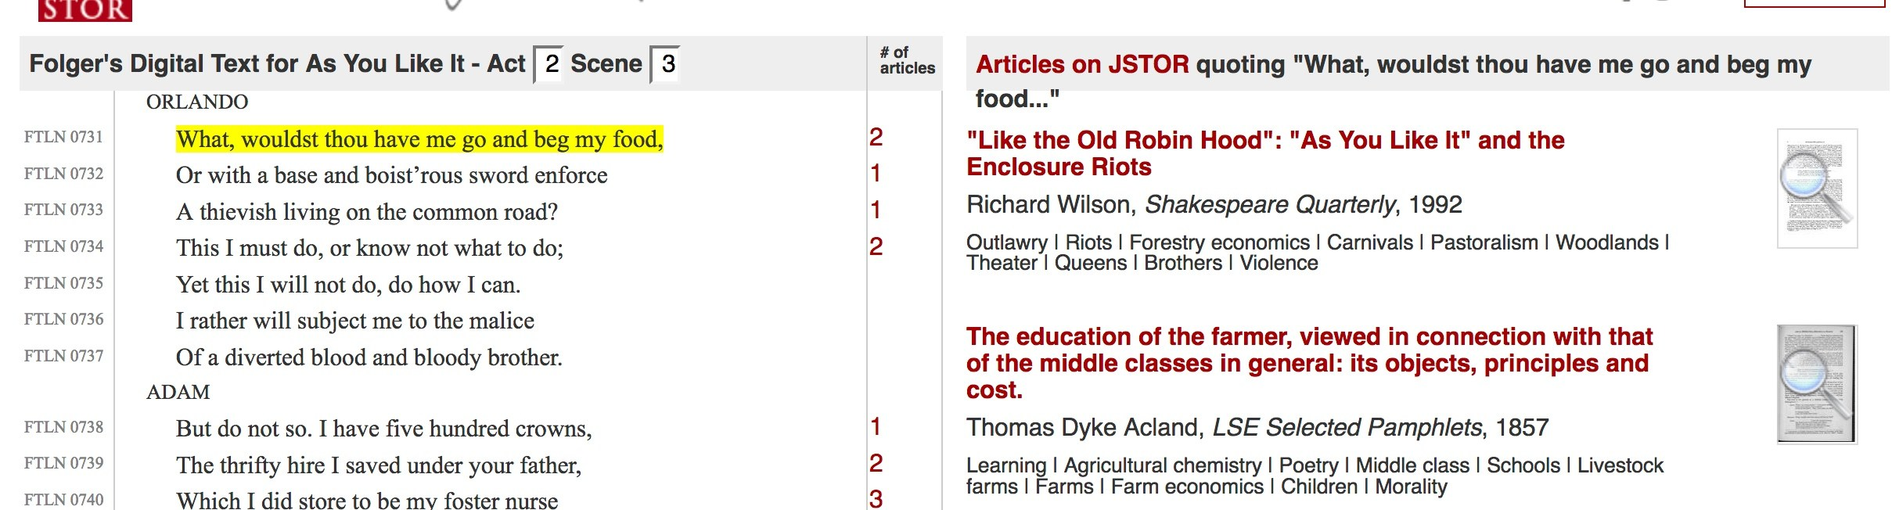
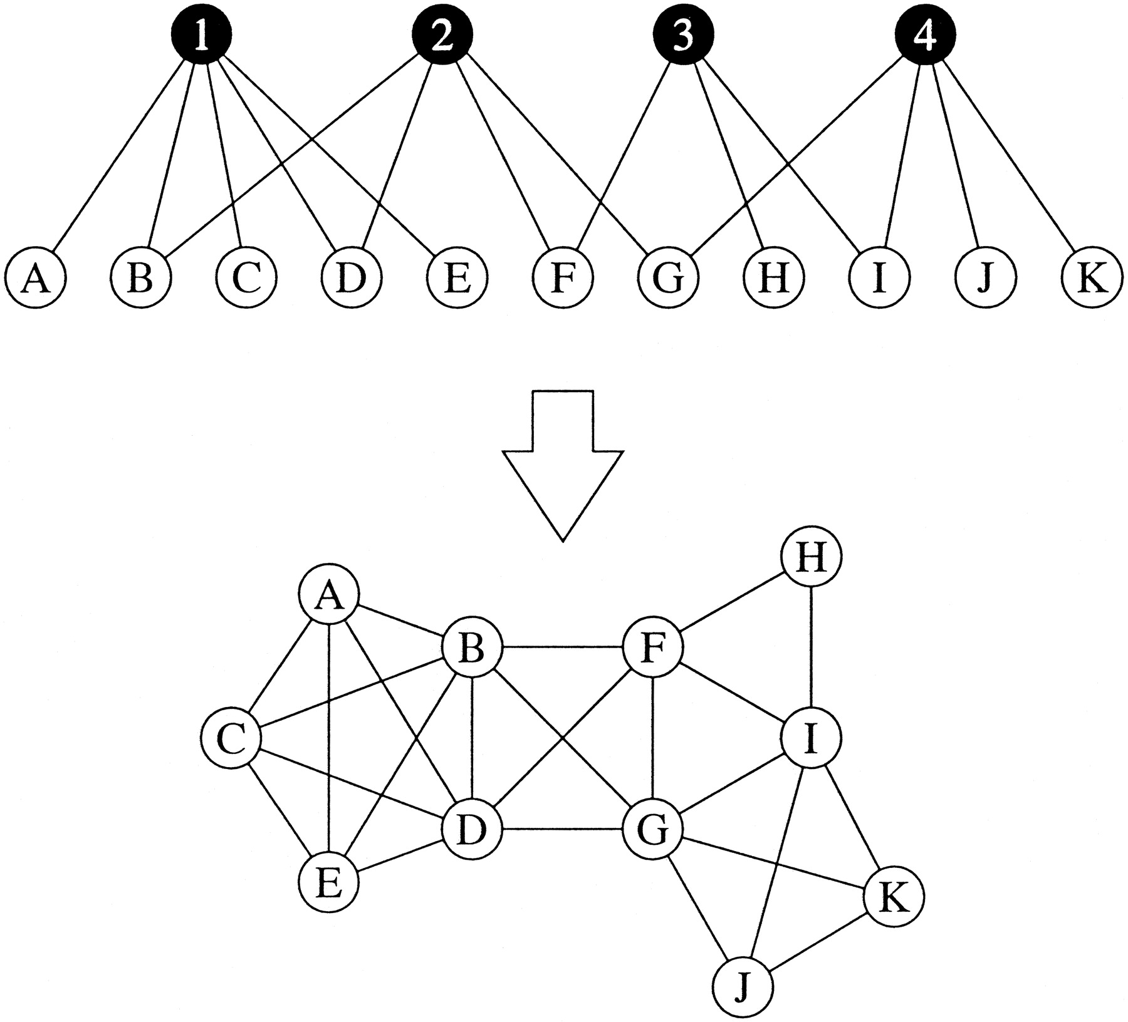
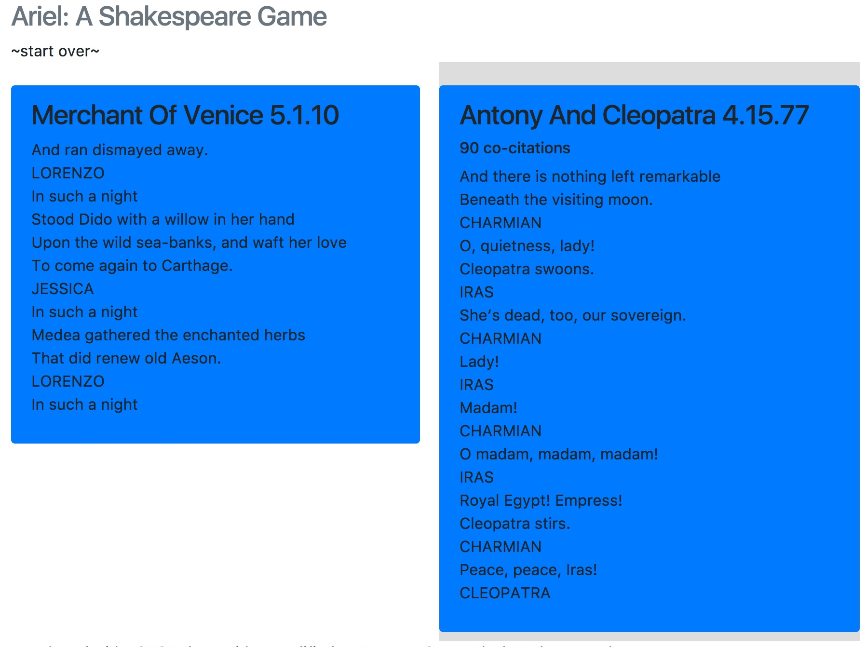
Shakespeare Problem (Thousands of hours on on one node)

Slide 7
Shakespeare Problem (Thousands of hours on on one node)
Lines
Lines
Matches
Matches

Slide 8
Shakespeare HTC structure (Condor)
Step 1 on Condor Network
68 hours real time
164 days compute time
Step 2 on Condor Network (60 days?)
produces
Submit Node
Match DB 1
Match DB 2
Compiler Script
Compiled DB
……
Match DB 1058
Match Finder Node 1
Match Finder Node 2
Match Finder Node 1058
……

Slide 9
Log into Davinci, and queue job

Slide 10
Shakespeare HPC/MPI Structure (Davinci)
Checkpoint Node
Write Node 1
(“Home”)
Write Node 2
(“Foreign”)
Match Finder Node 1
Match Finder Node 2
Match Finder Node 3
Match Finder Node N-3
……

Slide 11
Step 1. Assign Work Batch
Checkpoint Node
Write Node 1
(“Home”)
Write Node 2
(“Foreign”)
Match Finder Node 1
Match Finder Node 2
Match Finder Node 3
Match Finder Node N-3
……

Slide 12
Step 2. Record Results
Checkpoint Node
Write Node 1
(“Home”)
Write Node 2
(“Foreign”)
Match Finder Node 1
Match Finder Node 2
Match Finder Node 3
Match Finder Node N-3
……

Slide 13
Step 3. Record Work Batch Completion & Request New Batch
Checkpoint Node
Write Node 1
(“Home”)
Write Node 2
(“Foreign”)
Match Finder Node 1
Match Finder Node 2
Match Finder Node 3
Match Finder Node N-3
……

